Slide 1
Apache Spark Architecture
Fast, scalable, fault-tolerant distributed data processing
Presented By
Alok Khatri
Nandini Londhe
Samiksha Ingole
Omkar Gaikwad

Slide 2
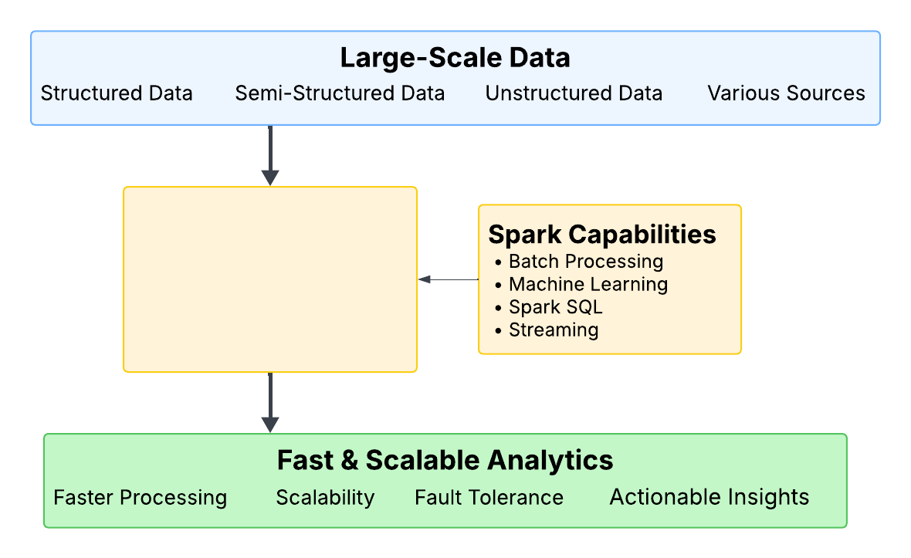
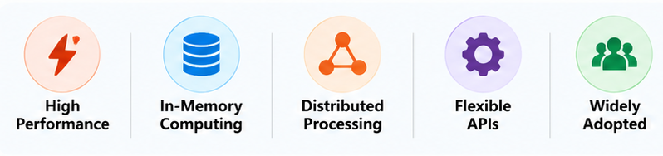
Introduction to Apache Spark
What is Apache Spark?
Open-source distributed processing framework
Designed for large-scale data processing
Uses in-memory computation
Faster than Hadoop MapReduce
Supports SQL, ML, Streaming & Graph Analytics
Apache Spark enables parallel processing of large datasets across multiple machines for fast and scalable analytics.

Slide 3
Why Spark is Needed
Challenges of Traditional Data Processing
Limited Memory
Large datasets exceed system memory.
Slow Processing
Sequential execution increases processing time.
Scalability Issues
Difficult to handle growing data volumes.
Single Point of Failure
System failure can stop the entire process.
Large Dataset
Benefits of Apache Spark
Distributed Processing
Workload distributed across multiple nodes
Scalability
Easily handles growing datasets
Fault Tolerance
Automatic recovery from failures
In-Memory Computing
Reduces disk I/O operations
High Performance
Faster than traditional MapReduce
Data Partitioning
Parallel Processing
Spark distributes data across multiple machines for faster, scalable, and fault-tolerant processing.

Slide 4
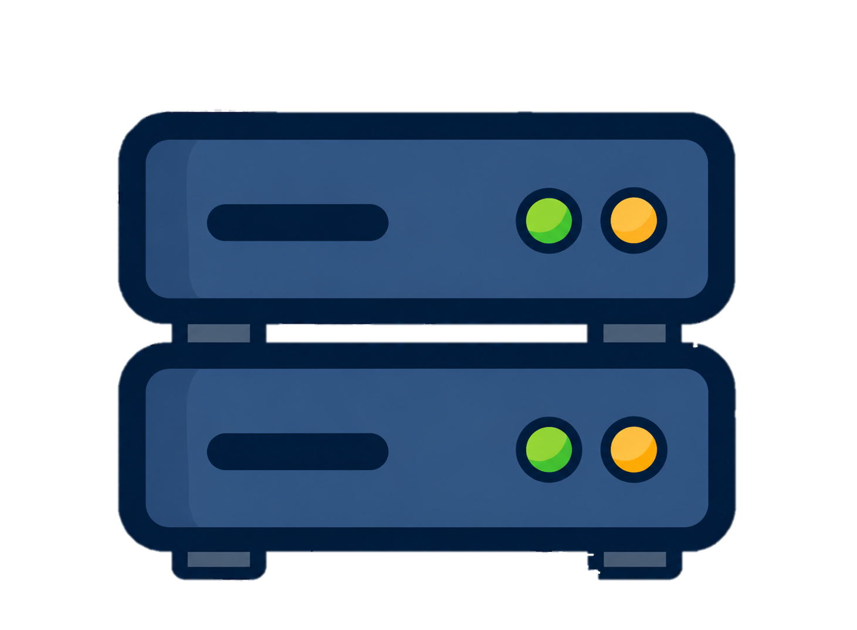
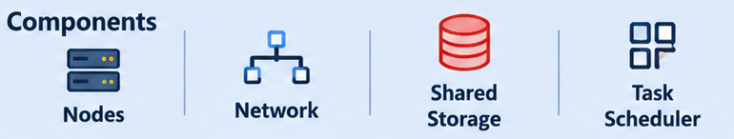
Distributed Computing Fundamentals
Independent computers working together to solve one problem.
Key Concepts
Parallel Processing
Multiple tasks run simultaneously.
Resource Sharing
Nodes share CPU, memory, and storage.
Fault Tolerance
Node failures do not stop the system.
Scalability
Add more machines as demand grows.
HOW IT WORKS
Task Scheduler
Node 1
Node 2
Node 3
Node 4
Spark processes large datasets by distributing tasks across multiple machines.

Slide 5


Spark Architecture Overview
Driver Program
Coordinates and schedules application execution.
Cluster Manager
Allocates cluster resources and launches executors.
Worker Nodes
Provide computing resources and host executors.
Executors
Run tasks on worker nodes and store intermediate data.
Tasks
Smallest units of execution that process data partitions.
User Application
Data Sources
Database Data
Driver Program
Documents/Files
Images/Media
Cluster Manager
Worker Node 1
Worker Node 2
Worker Node 3
Executor
Executor
Executor
Task
Task
Task
Task
Task
Task
Spark distributes processing across worker nodes while the driver coordinates execution and resource management.

Slide 6
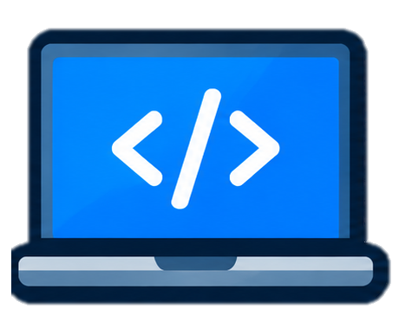

Driver Program and Cluster Manager
Driver Program
Coordinates the Spark
application
Responsibilities
Creates SparkContext / SparkSession
Builds the execution plan (DAG)
Schedules tasks on executors
Monitors application execution
User Application
Cluster Manager
Allocates cluster resources
Driver Program
Responsibilities
Manages CPU and memory
Launches executors
Allocates worker nodes
Monitors resource usage
Supported Managers
Cluster Manager
Worker Nodes
Standalone
YARN
Kubernetes
The Driver Program manages execution logic, while the Cluster Manager provides the resources needed to run the application.

Slide 7
Executors, Partitions and Tasks
Executors
Processes running on worker nodes that execute tasks.
Key Points
-Execute tasks in parallel.
-Store intermediate data in memory or disk.
Partitions
Logical divisions of data in an RDD or DataFrame.
Key Points
-Data is split into multiple partitions.
-More partitions improve parallelism.
Tasks
Smallest unit of execution in Spark.
Key Points
-One task processes one partition.
-Tasks run on executors.
Data Partitions
Worker Node
Partitions 1
Executor 1
Executor 2
Executor N
Partitions 2
Partitions 3
Task
Task
Task
Data Input
Partitions 4
Process Data
Process Data
Process Data
Each partition is processed by a task running on an executor, enabling parallel and distributed processing.

Slide 8
DAG, Jobs, Stages and Tasks
User Code
(Transformations + Actions)
DAG(Directed Acyclic Graph)
Execution plan created by Spark.
Optimizes task execution.
Determines the order of operations.
Job
Created when an action is triggered.
Represents a complete Spark operation.
Can contain multiple stages.
Stage
Group of parallel tasks.
Created based on shuffle boundaries.
Task
Smallest execution unit.
Processes one data partition.
DAG Creation
(Logical Execution Plan)
Job Generation
(Action triggers a Job)
Stage 1
(Set of parallel task)
Stage 2
(Set of parallel task)
Task
Task
Task
Task
Task
Task
Spark converts user operations into a DAG and executes them as Jobs → Stages → Tasks.

Slide 9
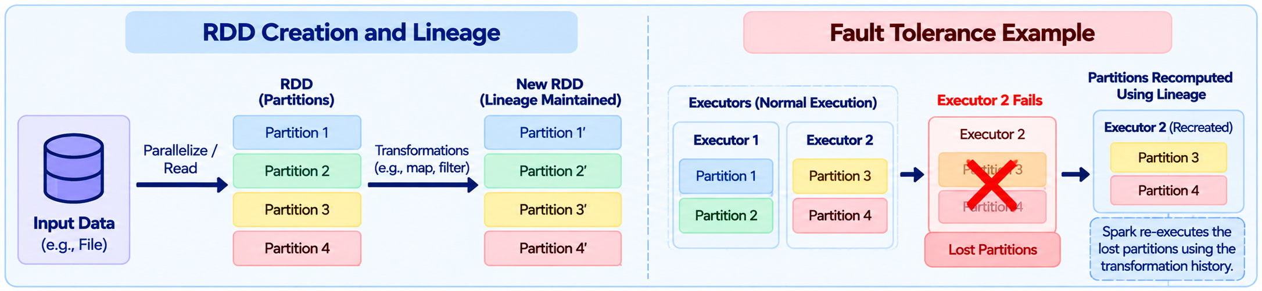
RDD and Fault Tolerance
RDD (Resilient Distributed Dataset)
Core data abstraction in Apache Spark.
Distributed across multiple partitions.
Supports parallel processing.
Immutable once created.
Fault Tolerance
Detects executor or node failures.
Recomputes only lost partitions.
Uses lineage information for recovery.
Ensures reliable distributed processing.
Spark uses RDD lineage to automatically recover lost partitions without storing duplicate copies.

Slide 10
Case Study: HPC Log Analytics
Problem Statement
Analyze large-scale HPC system logs to identify usage patterns, detect anomalies, and improve resource utilization.
Dataset
HPC job and system logs
Large volume (GBs/TBs)
Timestamp, user, job ID, resource usage, status
Stored in a distributed file system (e.g., HDFS)
Objectives
Process and analyze logs at scale using Spark
Identify usage patterns
Detect failures or anomalies
Generate insights for better resource management
Solution Architecture (Using Spark)
Key Analytics Performed
Job Usage Analysis
Total jobs
User-wise/job-wise statistics
Resource Utilization
CPU, memory, and runtime trends
Anomaly Detection
Identify failed jobs and unusual patterns
Time-based Analysis
Daily/weekly/monthly usage trends
Output / Insights
User and job usage reports
List of failed/anomalous jobs
Insights for capacity planning and optimization
HPC Logs
(e.g., HDFS)
Read Data
(spark.read.text / csv)
Data Processing
(parse, filter, transform)
Analytics
(aggregations, pattern detection)
Usage Analysis
(job counts, user stats)
Anomaly Detection
(failures, outliers)
Output Results
(dashboard / reports)

Slide 11
Spark in the Titan Supercomputer
Real-world application
Titan Supercomputer
Located at Oak Ridge National Laboratory (ORNL), USA.
One of the world's leading HPC systems for scientific computing.
Generates massive volumes of system and application logs.
Spark's Role
Processes distributed log data at scale.
Performs fast in-memory analytics.
Enables parallel processing across multiple nodes.
Extracts operational insights from HPC logs.
Results
Faster log analysis and query processing.
Improved system monitoring and fault detection.
Better understanding of resource utilization.
Scalable analytics for large HPC environments.
DATA PIPELINE
Titan Logs
System & application logs generated by HPC nodes
Cassandra
Distributed storage for scalable log management
Apache Spark
In-memory distributed data processing and analytics
Analytics Engine
Pattern detection, aggregation, and anomaly analysis
System Insights
Performance trends, fault analysis, and resource optimization

Slide 12
Conclusion
Spark provides a unified framework for large-scale distributed data processing.
In-memory computation improves performance compared to traditional processing systems.
Fault tolerance and scalability make Spark suitable for enterprise and HPC environments.
Real-world implementations, such as Titan HPC log analytics, validate Spark's practical impact and efficiency.

Slide 13
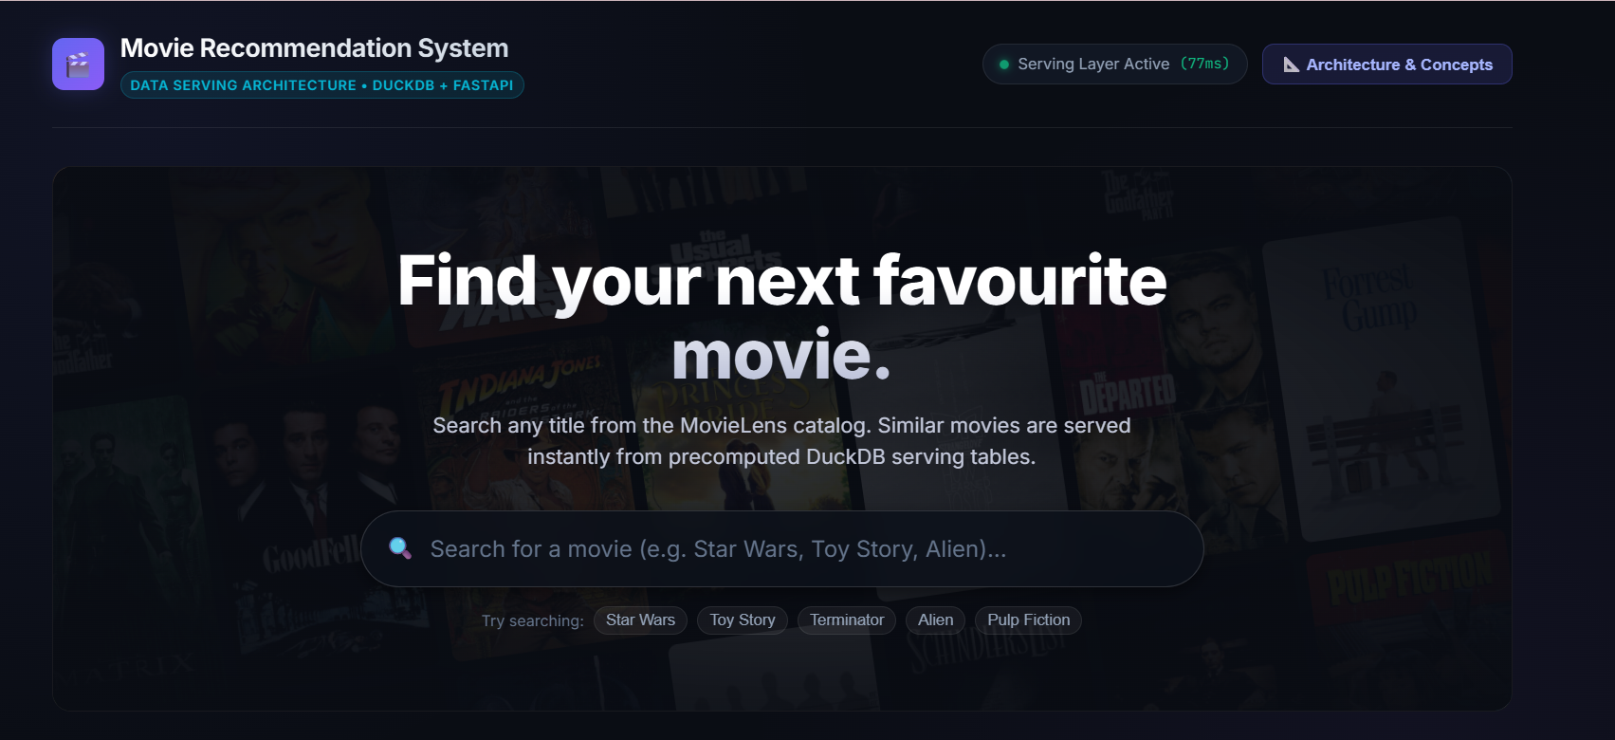
Movie Recommendation System Using Data Serving
Practical Implementation of Data Serving for Personalized Recommendations

Slide 14
Project Overview
Objective
Build a movie recommendation system that provides personalized movie suggestions using data serving techniques.
Movie Data
Recommendation Model
Dataset
Movie metadata (title, genre, etc.)
User ratings / interactions
Public dataset (e.g., MovieLens)
Data Serving (API)
Personalized Recommendations
Approach
Preprocess and analyze movie-user data
Build a recommendation model (e.g., collaborative filtering)
Serve recommendations using a data serving framework (e.g., FastAPI)
Use data serving to deliver real-time, personalized movie recommendations based on user preferences.

Slide 15
System Architecture
Components
User
Requests movie recommendations.
Interacts through the web interface.
Frontend (Web Interface)
Displays movie posters and recommendations.
Sends requests to the backend.
FastAPI Server
Handles recommendation requests.
Communicates with the ML model.
Recommendation Engine
Generates personalized recommendations.
Uses collaborative filtering techniques.
Movie Dataset
Stores movie metadata and user ratings.
Provides data for model training.
System Flow
User
Requests recommendations
Frontend
Web interface (React/HTML) Sends request
FastAPI Server
Handles API requests
Recommendation Engine
Collaborative filtering model
Movie Dataset
Movie metadata & user ratings
Recommended Movies
Personalized recommendations

Slide 16
Dataset and Data Preparation
Dataset Used
MovieLens Dataset
Publicly available movie recommendation dataset.
Contains movie information and user ratings.
Widely used for recommendation system research.
Suitable for collaborative filtering models.
Sample Movies Table
Movie ID | Title | Genre
1 | Toy Story | Animation, Comedy
2 | Jumanji | Adventure, Fantasy
3 | Grumpier Old Men | Comedy, Romance
Sample Ratings Table
Dataset Components
User ID | Movie ID | Rating
1 | 1 | 4.0
1 | 3 | 5.0
2 | 1 | 3.5
Movies Data
Movie ID
Title
Genres
Ratings Data
User ID
Movie ID
Rating
Timestamp
Model Training
Data Preparation Flow
Data Preparation Steps
Step 1:Clean missing or duplicate records.
Step 2:Merge movie and rating datasets.
Step 3:Create User–Movie Interaction Matrix.
Step 4:Prepare data for recommendation model training.
Movies Data
Ratings Data
Data Cleaning
Dataset Merge
User-Movie Matrix

Slide 17
Recommendation Model
Collaborative Filtering​
Recommends movies based on user behavior and similarities between users or items.
Types of Collaborative Filtering
User-Based Filtering
Finds users with similar rating patterns.
Recommends movies liked by similar users.
Item-Based Filtering
Finds movies similar to those the user liked.
Recommends similar movies.
Similarity Calculation
Uses cosine similarity to measure similarity between users or items.
Based on rating vectors.
Higher similarity indicates a stronger preference match.

Slide 18
Data Serving with FastAPI
What is FastAPI?
Modern Python framework for building APIs.
High-performance and easy to use.
Serves recommendations to users in real time.
Role of FastAPI
Receive Request
Accepts movie recommendation requests from users.
Process Request
Sends request to the recommendation engine.
Generate Recommendations
Model predicts suitable movies.
Return Response
Sends recommendations back to the frontend.
Example API Response
{
"user_id": 101,
"recommendations": [
"Inception",
"Interstellar",
"The Dark Knight",
"Avengers"
]
}
Benefits of Data Serving
Real-time recommendations.
Fast API response.
Easy integration with web applications.
Scalable deployment.

Slide 19
Conclusion
The movie recommendation system provides personalized suggestions based on user preferences and rating history.
Collaborative filtering helps identify similar users and recommend relevant movies effectively.
Proper data preparation and processing improve the accuracy and quality of recommendations.
FastAPI enables efficient real-time data serving between the recommendation engine and users.
This project demonstrates the practical use of Data Engineering and Machine Learning in recommendation systems.

Slide 20
References
[1] B. H. Park, S. Hukerikar, R. Adamson, and C. Engelmann, “Big Data Meets HPC Log Analytics: Scalable Approach to Understanding Systems at Extreme Scale,” in 2017 IEEE International Conference on Cluster Computing (CLUSTER), 2017, pp. 758–765.
[2] M. Zaharia et al., “Resilient Distributed Datasets: A Fault-Tolerant Abstraction for In-Memory Cluster Computing,” in 9th USENIX NSDI, 2012, pp. 15–28.
[3] M. Armbrust et al., “Spark SQL: Relational Data Processing in Spark,” in Proceedings of the 2015 ACM SIGMOD International Conference on Management of Data, 2015, pp. 1383–1394.
[4] C. Nwokwu, Data Engineering for Beginners. Hoboken, NJ, USA: John Wiley & Sons, Inc., 2026.

Slide 21
Thank You

